Slide 1

PLANT GROWTH AND DEVELOPMENT:

Slide 2
PLANT GROWTH AND DEVELOPMENT: PRODUCTION, USE, AND STORAGE OF FOOD IN PLANTS

Slide 3
Introduction
Within a plant, many physiological processes are constantly occurring to allow for the plant’s growth and survival.

Slide 4
Chemical reactions within the leaves produce sugar molecules.
Water molecules move these sugar molecules to all the cells throughout the plant.
Organelles within the cells convert the sugar molecules into energy for cell division and expansion.

Slide 5
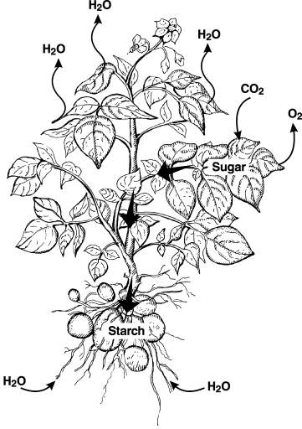
Plant processes that occur within a plant include:
photosynthesis,
respiration,
transpiration, and
translocation.

Slide 6
Photosynthesis
The term photosynthesis derives from the words photo (light) and synthesis (putting together).
Photosynthesis is the process by which green plants, algae, and certain classes of bacteria capture solar energy and use it to make simple sugar molecules.

Slide 7
Photosynthesis song
http://www.youtube.com/watch?v=C1_uez5WX1o&list=PLC7A34651BCB66CA9&index=1&feature=plpp_video

Slide 8
These simple sugars are then used as an energy source for growth and development.
Photosynthesis is the single most important plant biological process because it provides food and oxygen needed for human survival.

Slide 9
The process of photosynthesis occurs within the chloroplasts of plant cells.
These cell organelles contain numerous chlorophyll pigments, which absorb mostly blue and red wavelengths of sunlight.

Slide 10
Most photosynthesis occurs in the plant leaves because the cells within these plant organs have the highest concentration of chloroplasts.
http://youtu.be/ZH61SIJrxuU

Slide 11
In the presence of light energy, six carbon dioxide molecules combine with six water molecules.
This reaction produces one simple sugar molecule, along with six molecules of oxygen.

Slide 12
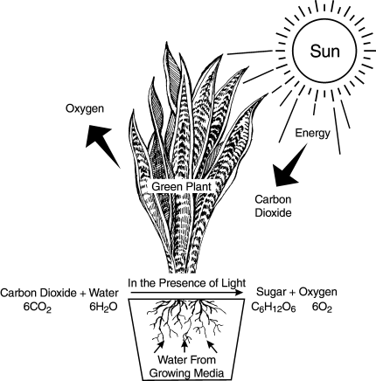
The chemical reaction formula for photosynthesis is:
6CO₂ + 6H₂O = C₆H₁₂O₆ + 6O₂

Slide 13
A plant uses the oxygen molecules produced during photosynthesis for other chemical processes occurring at the same time as photosynthesis.
Excess oxygen molecules pass through the open stomata of the plant leaves and escape into the air.

Slide 14
Water within the plant transports the sugar molecules from the leaves to other parts of the plant, where they are converted into molecules of carbohydrates, lipids, proteins, cellulose, and lignin.

Slide 15
Two types of reactions are involved in the process of photosynthesis:
light reaction, and
dark reaction.

Slide 16
Light reactions occur within the thylakoids n the granum and change light energy into chemical energy.
Dark reactions occurs in the stroma result in carbon fixation (the production of sugar molecules); they also produce amino acids and lipids for cellular functions.

Slide 17
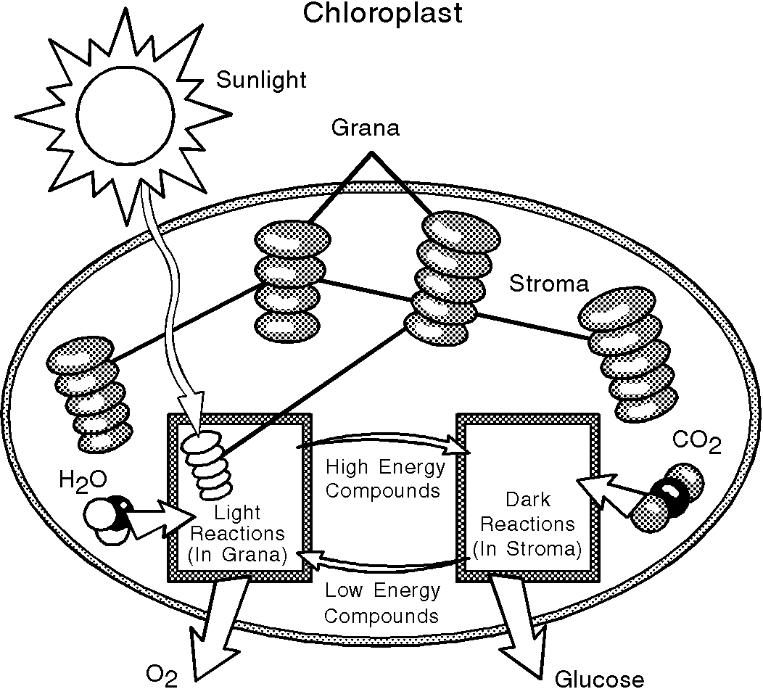

Slide 18
Dark reactions occur mostly during the day, but light is not required for these reactions to occur.
Dark reactions of photosynthesis provide the raw materials to produce almost everything a plant needs!

Slide 19
Respiration
Respiration is the cellular process that converts the simple sugar molecules produced during photosynthesis into useful energy.
http://youtu.be/sblPT7SYH6s

Slide 20
Through a series of reactions, one simple sugar molecule and six oxygen molecules break down into six molecules of carbon dioxide and six molecules of water, while also producing energy for plant use.

Slide 21
The chemical reaction formula for respiration is:
C₆H₁₂O₆ + 6O₂ = 6CO₂ + 6H₂O + energy
The chemical process of respiration is nearly the opposite of photosynthesis.

Slide 22
Comparison of Photosynthesis to Respiration
Photosynthesis
Respiration
Food: | Created | Used
Energy: | Stored | Released
Location: | Chloroplast | Mitochondria
Oxygen: | Released | Used
Carbon Dioxide: | Used | Released
Sunlight: | Required | Not Required

Slide 23
Both photosynthesis and respiration reactions show the importance of water, oxygen, and carbon dioxide for plant growth and development.

Slide 24
A plant uses about 25% of the sugar manufactured during photosynthesis for energy.
The remainder of the manufactured food reserve is stored throughout the plant.

Slide 25
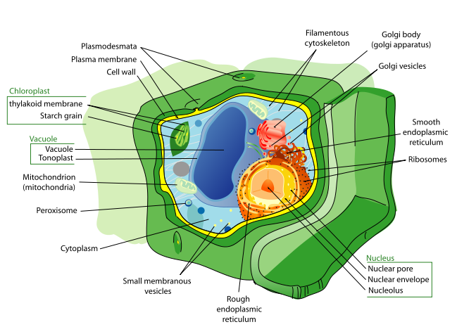
Respiration occurs mostly within the mitochondria of a plant cell.
Mitochondria
Illustration by Lady of Hats courtesy of Wikipedia.

Slide 26
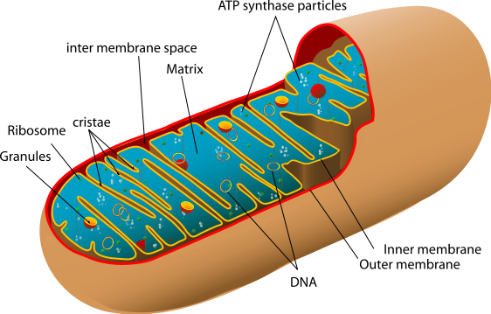
Mitochondria are plant cell organelles that consist of an outer membrane and a folded inner membrane (cristae).
Illustration by Lady of Hats courtesy of Wikipedia.

Slide 27
The process of respiration consists of three phases:
glycolysis,
Krebs cycle, and
electron transport system.

Slide 28
Glycolysis is the first phase of plant respiration.
It occurs within the cell cytoplasm, just outside of the mitochondria.
During this phase, sugar molecules break down so they are small enough to pass through the outer layer of mitochondria.

Slide 29
During glycolysis, a small amount of energy is released.

Slide 30
The second phase of plant respiration is the Krebs cycle.
This phase occurs inside the mitochondria, near the outer membrane.

Slide 31
The Krebs cycle consists of a series of reactions that produce a few high-energy ATP and electron molecules used in the third phase of respiration.
Also during this phase, carbon dioxide forms from the carbon atoms in the sugar molecule.

Slide 32
The electron transport system is the third phase of plant respiration.

Slide 33
During this phase, which occurs near the cristae of the mitochondria, large amounts of high-energy ATP molecules are formed from the high-energy electrons passing along a chain of electron transport carriers.

Slide 34
Molecules of water are also produced.
The presence of oxygen molecules is especially important during this phase because they are the final acceptors of electrons in the electron transport system.

Slide 35
Transpiration
Transpiration is the process by which water vapor evaporates into the atmosphere through the leaf pores or stomata.
http://youtu.be/mc9gUm1mMzc

Slide 36
As water evaporates through the leaf pores, it pulls water up through the plant by means of a water potential gradient that exists from the soil, through the plant, and into the atmosphere.

Slide 37
Water potential is a measure of the energy available in a solution to cause water molecules to move.
Solute concentration and pressure are two main factors responsible for water potential values.

Slide 38
Water potential is greatest in the soil and lowest in the atmosphere, with intermediate values within the plant.
Water moves in the direction of lowest water potential; thus, within a plant, water moves upwards from the roots, through the plant, and out into the air.

Slide 39
Water functions as the medium for transporting nutrients absorbed from the soil up into the plant.
Water molecules adhere to each other and move up through the xylem in response to the water pressure gradient.

Slide 40
Without the process of transpiration, plant roots would not be able to absorb water and dissolved nutrients from the soil, which are essential for the plant’s survival.

Slide 41
Wilting occurs when more water transpires through the plant than what it can absorb from the soil.
Wilting is usually caused by:
lack of water in the soil, or
damaged roots incapable of absorption.

Slide 42
A lack of water within a plant causes the plant to lose its rigidity.

Slide 43
Damage occurs when the severity of the lack of water exceeds the plant’s ability to recover, regardless of the amount of water added later.
This is called permanent wilting point.

Slide 44
Factors that influence transpiration rates include:
environmental factors, such as temperature, humidity, and wind; and
plant features, such as leaf size, leaf structures, and modifications.

Slide 45
Translocation
Translocation is the process in which manufactured food reserves produced by a plant move from areas of higher concentrations (the leaves) to areas of lower concentrations (roots, buds, fruits).

Slide 46
Translocation occurs in the phloem of the vascular system.
Source cells near chloroplasts transfer the food reserves made during photosynthesis to the phloem.

Slide 47
Water serves as the medium for transporting the food reserves throughout the phloem.
Transfer cells are involved in unloading the food reserves from the phloem.

Slide 48
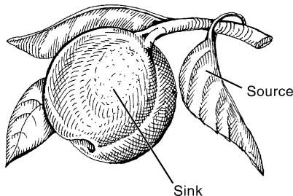
The “source” site is the region of the plant that produces and moves food reserves to a receiving or “sink” site.

Slide 49
Plant leaves are the primary “source” sites because of the high level of photosynthesis that occurs.
Developing regions of the plant, such as the roots, fruits, and buds, are “sink” sites because they do not photosynthesize enough food to meet their needs.

Slide 50
At “sink” sites, growing tissues use the food reserves as a source of energy.
These sites also exist for storage purposes.

Slide 51
Food reserves stored at these sites change into starch compounds, which must be broken down later during plant respiration.

Slide 52
Storage of Food in Plants
Simple sugars manufactured during photosynthesis function as stored energy needed by the plant for growing new cells and tissues.
This stored energy exists in the form of carbohydrates, lipids, and proteins.

Slide 53
Food manufactured through photosynthesis, but not used for tissue development or energy, is stored within the plant.

Slide 54
Plants store food in their:
seeds,
roots,
stems, and
other parts (fruits).

Slide 55
Carbohydrates are composed of carbon, hydrogen, and oxygen.
Carbohydrates comprise almost all of the total dry weight of a plant; they include starches, sugars, and fructosans.

Slide 56
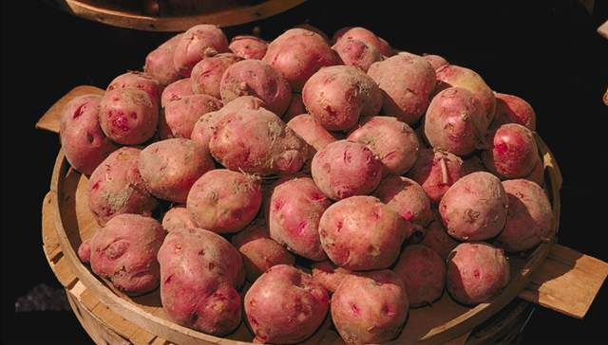
Starch, usually the most abundant food stored in plants, is found in great quantities in grain and tuber crops.
Photo by Bill Tarpenning courtesy of USDA Photography Center.

Slide 57
Lipids (fats and oils), which are also composed of carbon, hydrogen, and oxygen, exist in different proportions of elements as compared to carbohydrates and are insoluble in water.

Slide 58
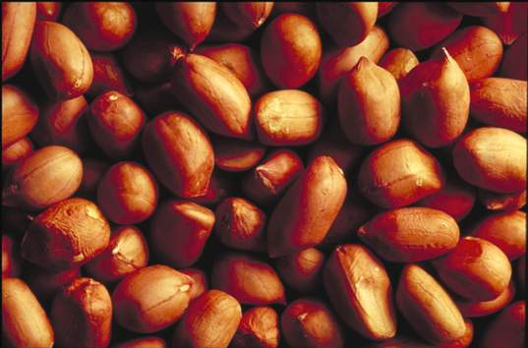
Fats and oils are stored in many types of plant seeds, such as peanuts and sunflowers which are two crops with seeds that have high contents of fats and oils.
Photo by Jack Dykinga courtesy of USDA Photography Center.

Slide 59
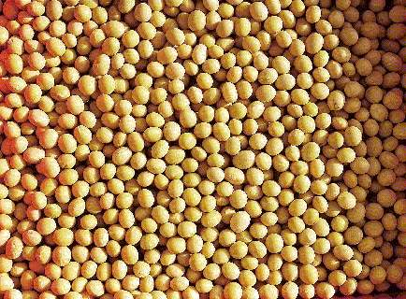
Proteins are used in plant cell production and are found at high levels in seeds of many crops.
Photo by Lynn Bettis courtesy of USDA Natural Resources Conservation Service.

Slide 60
Protein molecules contain carbon, hydrogen, oxygen, and nitrogen.

Slide 61
Similar to digestion in animals, plants must convert carbohydrates, lipids, and proteins into soluble forms that they can use and then assimilate these products into living material (protoplasm).

Slide 62
Summary
Many physiological processes are ongoing in a plant to produce food molecules for the cells and to convert food into energy for cell division and expansion.

Slide 63
Photosynthesis is a process by which plants capture solar energy and use it to make simple sugar molecules.
Respiration is the complex cellular process that converts the simple sugar molecules produced during photosynthesis into useful energy.

Slide 64
Transpiration is the evaporation of water vapor released into the atmosphere by the leaves and other parts of the plant.
Transpiration allows water to move throughout the plant, moving food reserves and nutrients.

Slide 65
Simple sugars manufactured during photosynthesis are building blocks for carbohydrates, lipids, and proteins, which are used for tissue development or energy.
Excess food is stored in the seeds, roots, stems, and other specialized parts of plants.

Slide 66
ALL RIGHTS RESERVED
Reproduction or redistribution of all, or part, of this presentation without written permission is prohibited.
Instructional Materials Service
Texas A&M University
2588 TAMUS
College Station, Texas 77843-2588
http://www-ims.tamu.edu
2007

